Slide 1
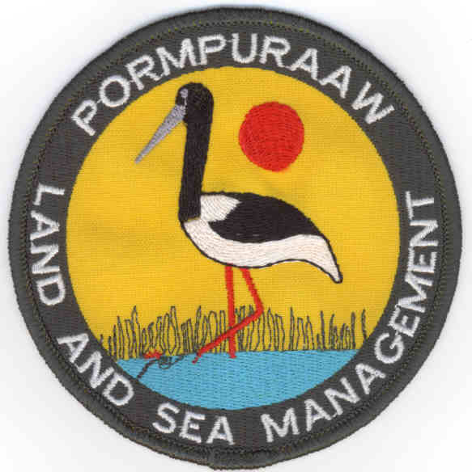
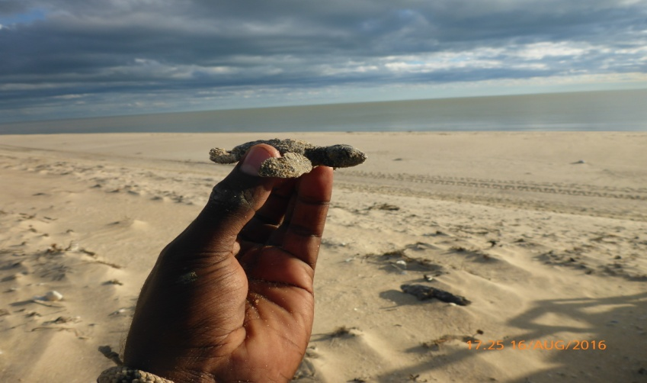
Pormpuraaw
W.C.T.T.A.A.
Review 2014/2015/2016

Slide 2
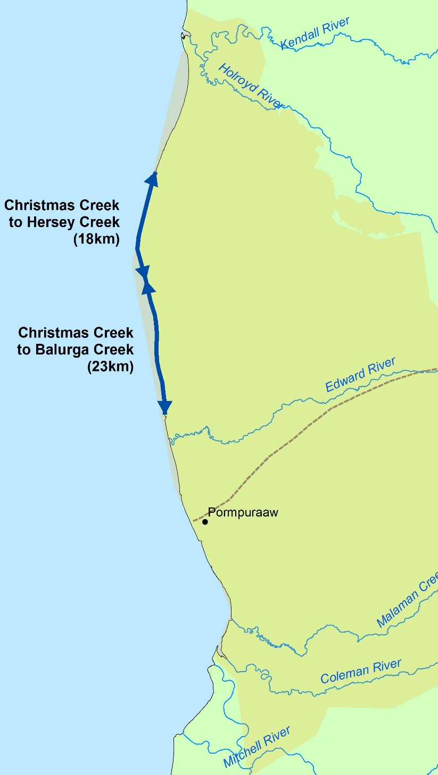
Program Overview
Pormpuraaw Land Sea Rangers commenced monitoring of the Olive Ridley turtle nesting colonies on the 85 kilometers of Pormpuraaw coastline north of the community in 2009, the first four years were not well planned, with limited resources and manpower available
Duration of the nesting season is 4 months, starting late May, early June, through to mid to late September
Access to the nesting colonies is by 4x4 vehicles only, with late wet season activity (rain after March) often preventing vehicle access till mid June
The nesting sites are very remote with a monitoring patrol from the community to the first nesting beach and back (165 kilometers round trip) taking 6 hours
In 2015 PLASM built a semi-permanent camp at Xmas Creek which is manned throughout the 4 month nesting season on a rotating shift basis

Slide 3
The first four years of monitoring (2009 to 2013) revealed 90% + predation by feral pigs of all nests detected, during this time aerial feral control was undertaken by contractors and funding dependent, usually one two day cull annually, no effective passive predator exclusion devices were available, some minor success in reducing predation was achieved by regular human presence/ground shooting on the very remote coastline (10/80 was not utilized due to strong TO objection)
The formation of WCTTAA in 2013 resulted in a substantial increase in applied effort from 2014 onwards, funding became available to pursue specialist training opportunities allowing local traditional owner Ranger staff to implement all required predator control activities without reliance on contractors
PLASM began trialing new passive control measures developed from extensive predation observations/trail cam imagery throughout the first four years of monitoring (2009 to 2013)

Slide 4
Predation Management (Active)
PLASM staff attained aerial control licensing and CASA accreditation in 2014 and began a cost effective aerial control regime of multiple control rounds timed to coincide with the onset of nesting activity and food/water availability, the use of a single R22 chopper four times annually x 1 ½ days duration proved highly effective in reducing pig numbers and associated nest predation levels, a fifth round of culling in Late November with two R22 choppers x 1 ½ days in 2015 and 2016 yielded in in excess of 900 pigs on both occasions, this late cull was timed to coincide with very limited water /food availability resulting in target animals forced to gather at known inland water points
Late night/early morning patrols with pig dogs is another proven control method for shy/smart pigs, some areas adjoining the coastline are very heavily vegetated (monsoon rainforest) and cannot be effectively aerial shot
Throughout the 8 years of monitoring ,many bait stations were established and maintained with a variety of food options, none were visited by target animals

Slide 5
Feral animal control by year

Slide 6
Aerial cull areas by year

Slide 7
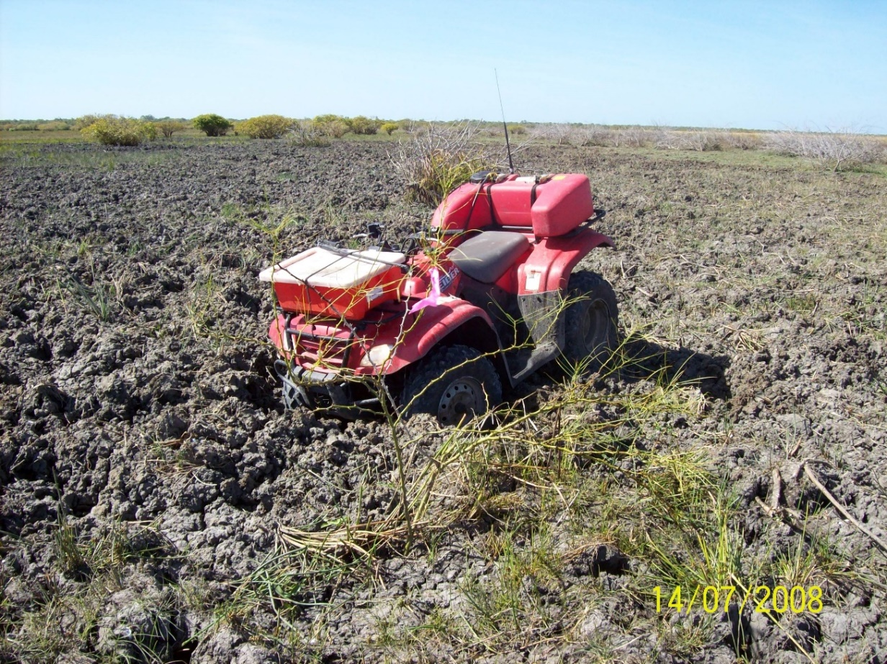
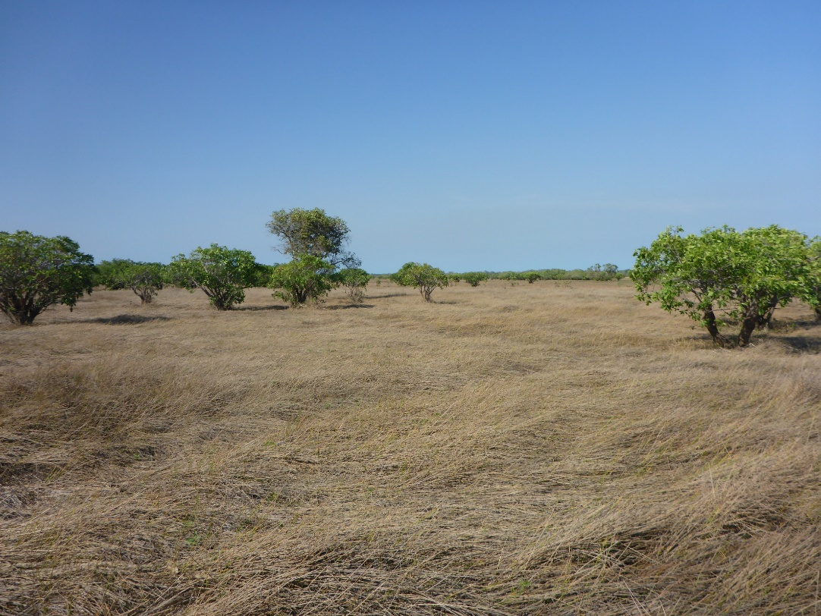
Other benefits of removing pigs…
2008
2016

Slide 8
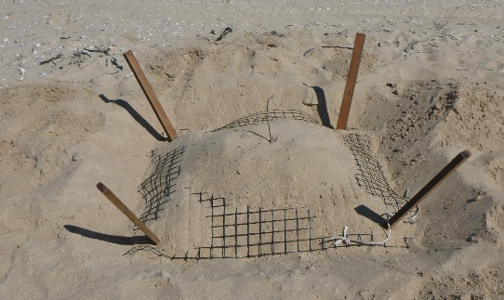
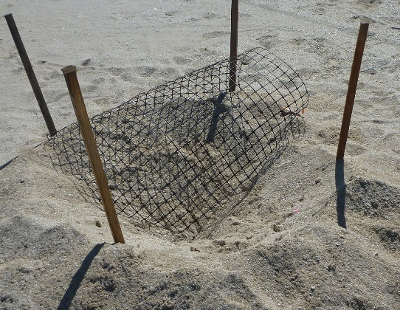
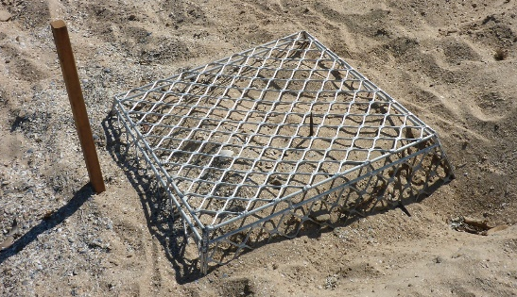
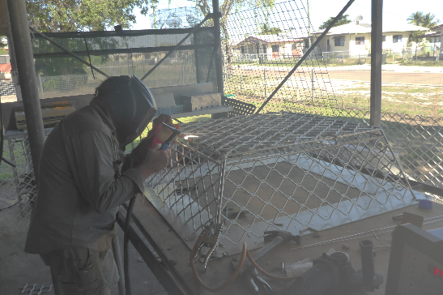
Predation management (Passive)
2013 and 2014 trialed predator exclusion with plastic trellis mesh. Limited success was achieved excluding goannas, but pigs simply grabbed the mesh and tore it out of the sand, then predated the nest.
End 2014 season; PLASM staff drew plans for new design of aluminum predator exclusion cage. Design concept had to achieve – stackable for ATV carriage, reusable, very robust, predator proof and hatchling departure friendly.
March 2015 met with a metal fabricator and Ranger Robbie oversaw the construction of the first cage. 30 cages were then purchased for trial in the 2015 season.
Throughout 2015 and 2016 these 30 cages, plus another 50 purchased, were installed on over 200 Olive Ridley nests. repeated attempted predation trail camera imagery by pigs and goannas was recorded, to date, the cages have proved 100% predator proof.
PLASM Ranger staff now manufacture the aluminum cages in house.

Slide 9
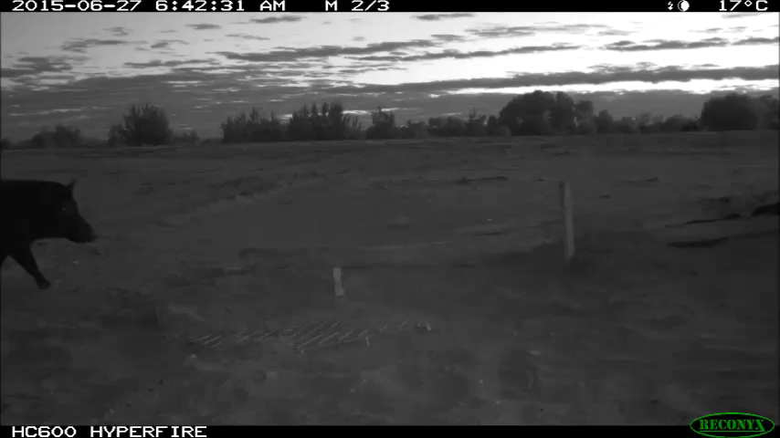
Cages have worked on pigs….

Slide 10
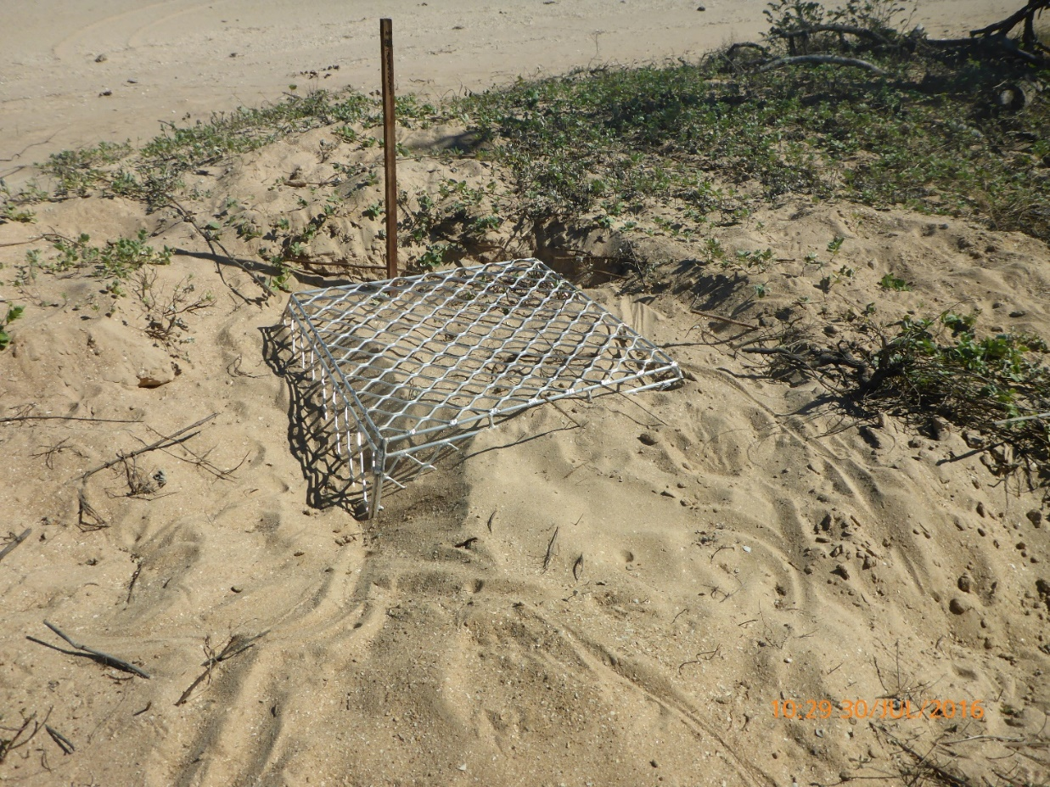
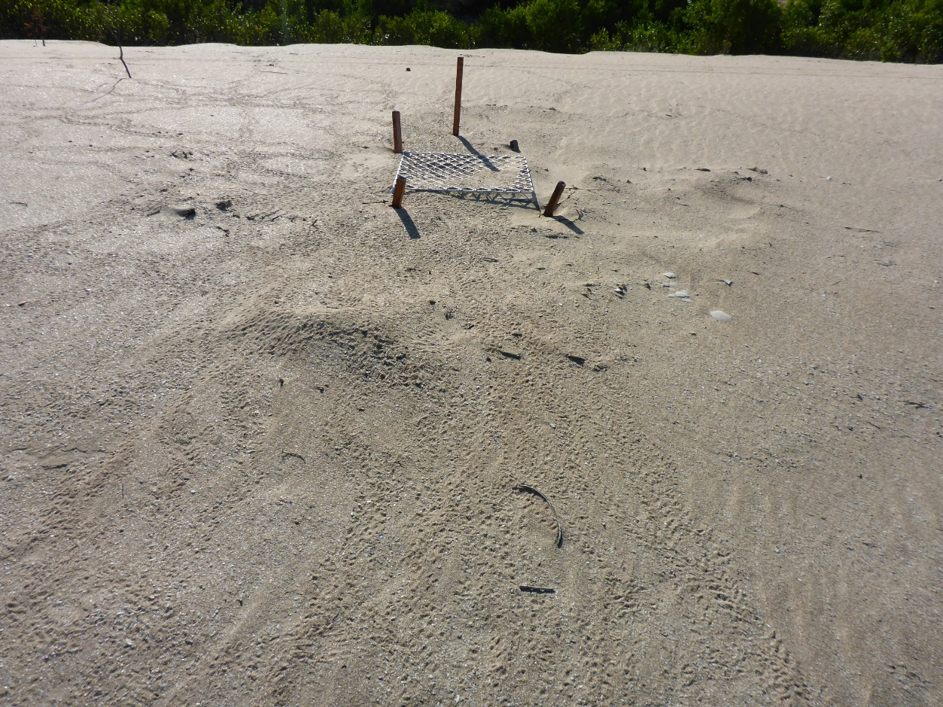
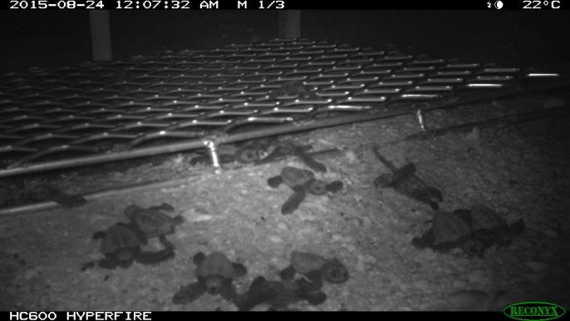
… and goannas

Slide 11
Olive Ridley hatchling success by year
n=number of nests

Slide 12
Who were the predators?

Slide 13
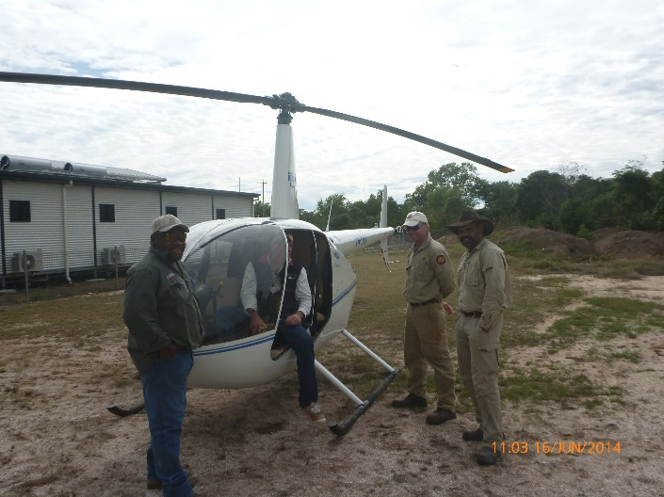
Successes
Staff Development
Training and accreditation of local Traditional Owner Ranger staff for attainment of aerial feral control licensing
Attainment of Cat. D weapons and licensing
All Ranger staff attain Cert III CALM
Predator management
Development of a proven predator proof nest protection device
Development and implementation of ongoing cost effective aerial predator control regime specific to Pormpuraaw D.O.G.i.T
Nest Success
Increase in nest success over the last three years
Funding
WCTTAA has successfully attracted funding since its formation through dedicated teamwork by local Traditional Owner Ranger member groups
(52% increase at Xmas)
(37% increase at Hersey)

Slide 14
Challenges
Logistical program delivery due to very remote operational zones
Duration of Olive Ridley nesting season (4 months)
Variations in weather patterns (late rain) preventing access to nesting beaches
Predator control requires late night/early morning shift work
Maintaining turtle camp shift roster for 4 months
Delivery/completion of other QILASRP work plan milestones
Delivery/completion of Carbon Abatement program
Machinery maintenance requirements for extended ATV monitoring/predator abatement patrolling on soft, sharply inclined foreshore environments
Maintaining safe work practices over extended periods

Slide 15
Lessons Learned

